Slide 1




Location Optimization for Italian Restaurant in Toronto
Mengzhen Chen
6/20/2020

Slide 2
Introduction
Objective:
find the most suitable location for the entrepreneur to open an Italian restaurant in Toronto, Canada
Requirements:
Open the restaurant in locations where many Italian restaurants around

Slide 3
Data
List of neighborhoods in Toronto, China
Latitude and Longitude of Toronto
Venue data related to Italian restaurants

Slide 4
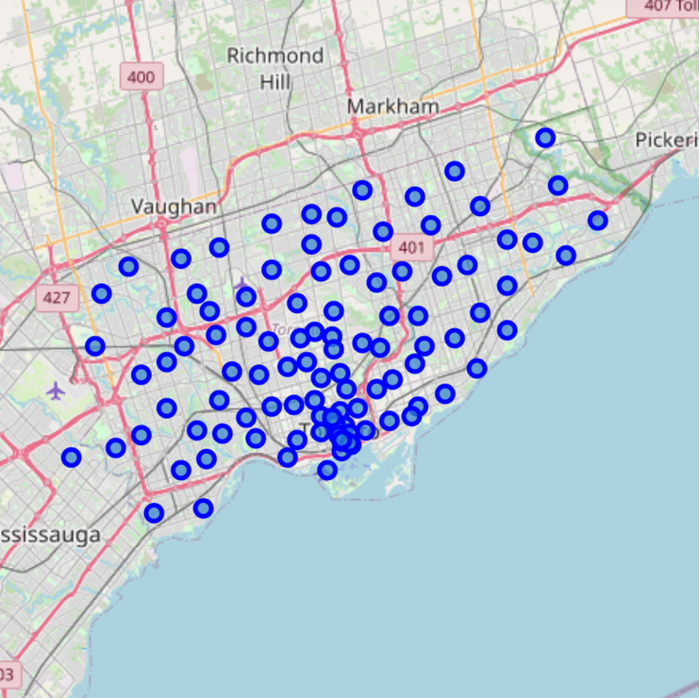
Methodology
Latitude and Longitude of Toronto

Slide 5
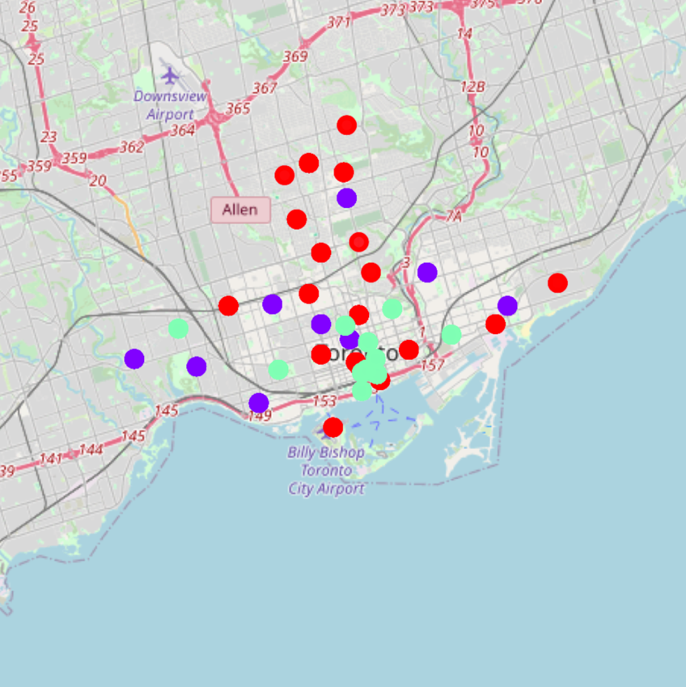
Methodology
Clustering (based on Italian restaurants)

Slide 6
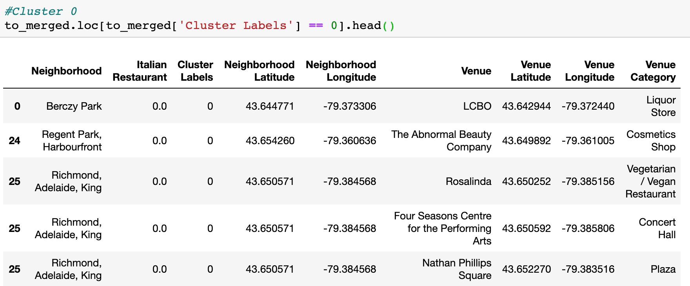
Results
Cluster 1

Slide 7
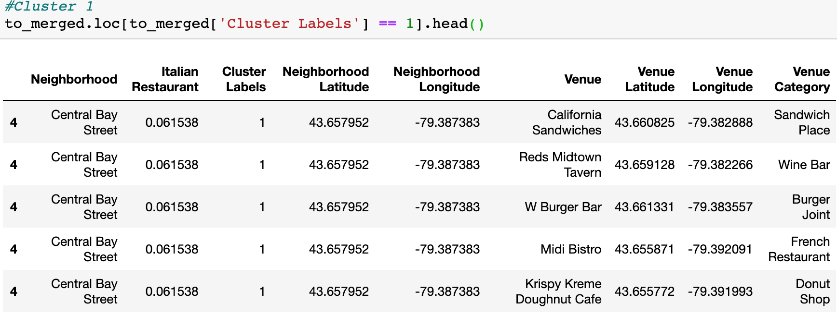
Results
Cluster 2

Slide 8
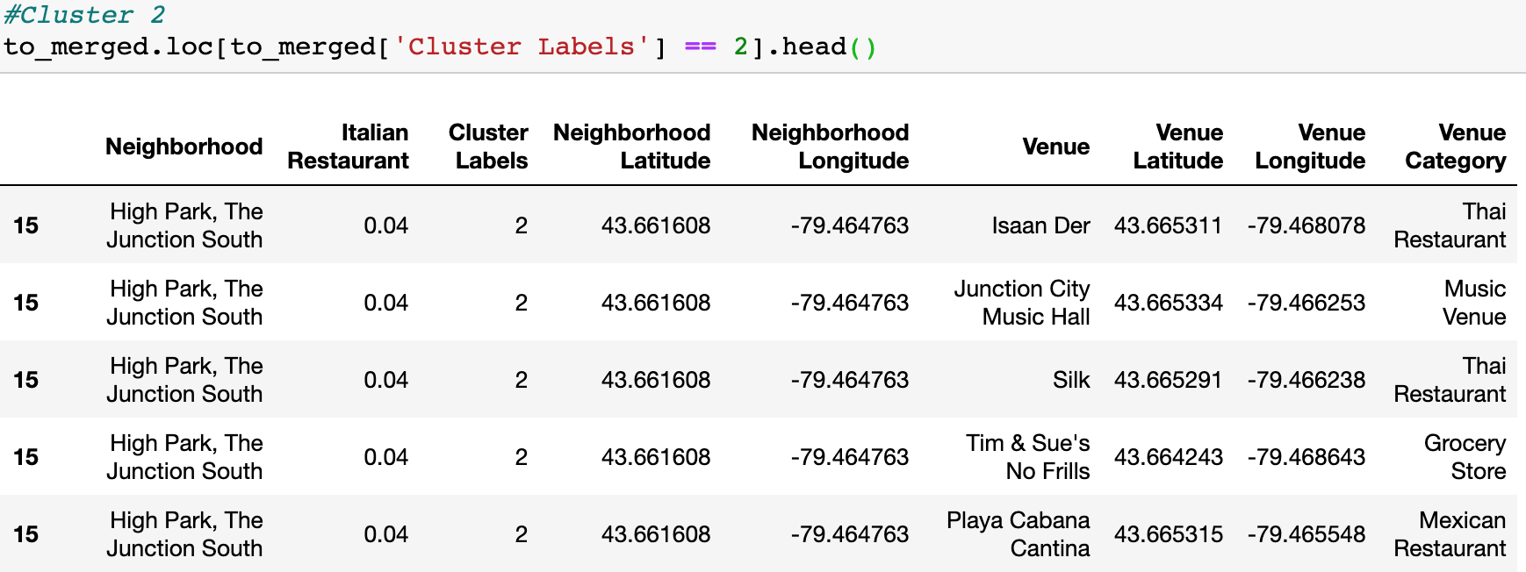
Results
Cluster 3

Slide 9
Conclusion
Most of Italian restaurants are in Cluster 1. In Cluster 1, Italian restaurants are most likely to locate around Central Bay Street, Runnymede Swansea and the Beaches Street where many restaurants shops around.
There are some Italian restaurants in Cluster 2 which is also business areas especially restaurant area.
Looking at nearby venues, it seems Cluster 1 might be a better location comparing to Cluster 2 as there are a lot of restaurants in these areas.
Therefore, the entrepreneur should open the Italian restaurant in Cluster 1 areas.

Slide 10

Note
One more thing should consider Competition
The entrepreneur would better to seek more information about the market competition to decide the location and maximize the profits.

